Slide 1
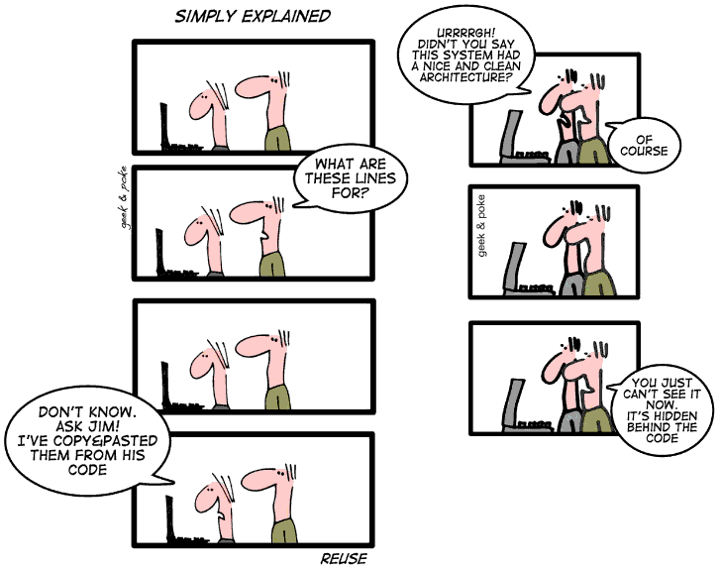

Slide 2
CS 471-1/571
Ch8 Reusability and Portability

Slide 3
Overview
Reuse concepts
Reuse during design and implementation
Sample design patterns
Portability

Slide 4
Reuse Concepts
Reuse is the use of components of one product to facilitate the development of a different product with different functionality
Opportunistic (accidental) reuse
  First, the product is built
  Then, parts are put into a database for reuse
Systematic (deliberate) reuse
  First, reusable parts are constructed
  Then, products are built using these parts

Slide 5
Why Reuse?
To get products to the market faster
  There is no need to design, implement, test, and document a reused component
On average, only 15% of new code serves an original purpose
  In principle, 85% could be standardized and reused
  In practice, reuse rates of no more than 40% are achieved

Slide 6
Impediments to Reuse
Not invented here (NIH) syndrome
Concerns about faults in potentially reusable routines
Storage–retrieval issues
Cost of reuse
Intellectual property and legal issues
Lack of source code for COTS components

Slide 7
European Space Agency: Ariane 5
Ariane 5 rocket blew up 37 seconds after lift-off
  Cost: $500 million
  The on-board computers crashed, and so did the rocket
Reason: An attempt was made to convert a 64-bit integer into a 16-bit unsigned integer
  The Ada exception handler was omitted
Reuse of Ariane 4 software
  unchanged and untested on the Ariane 5

Slide 8
The Cause and Lesson
Ten years before, it was mathematically proven that overflow was impossible on the Ariane 4
    The assumptions for the Ariane 4 did not hold for the Ariane 5
  Because of performance constraints, conversions that could not lead to overflow were left unprotected
Lesson
  Software developed in one context needs to be retested when integrated into another context

Slide 9
Types of Design Reuse
Library and toolkit
Application frameworks
Design patterns
Software architecture and product lines
Component-based software engineering

Slide 10
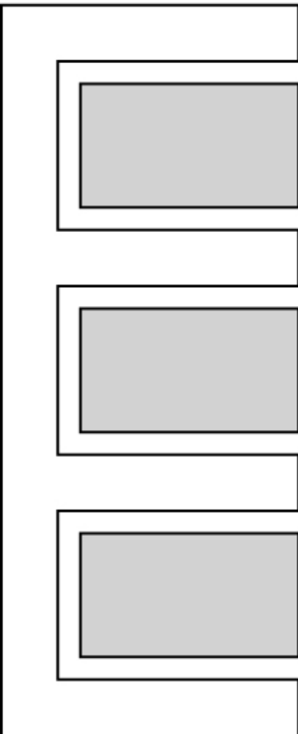
Library or Toolkit
A set of reusable classes/routines
Examples
  GUI class library or toolkit
  Scientific software
The user is responsible for the control logic (white in figure)

Slide 11
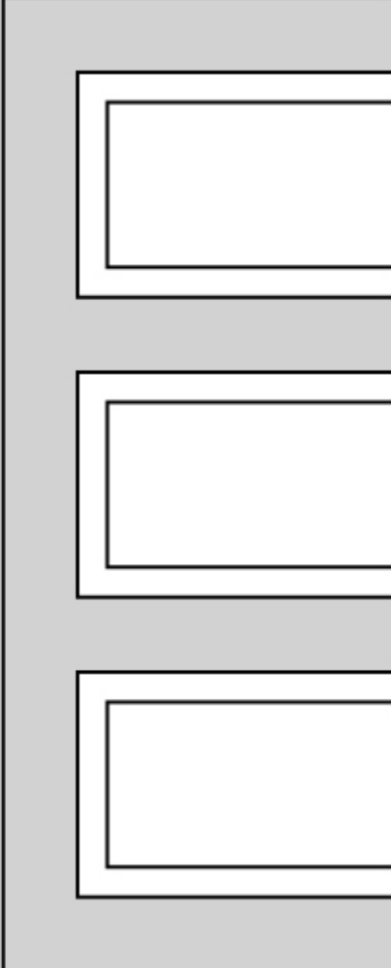
Application Framework
A framework incorporates the control logic of the design
The user inserts application-specific routines in the “hot spots” (white in figure)

Slide 12
Application Framework - cont
Faster than reusing a toolkit
  More of the design is reused
  The logic is usually harder to design than the operations
Example:
  IBM’s Websphere
    Formerly: e-Components, San Francisco
    Utilizes Enterprise JavaBeans (classes that provide services for clients distributed throughout a network)

Slide 13
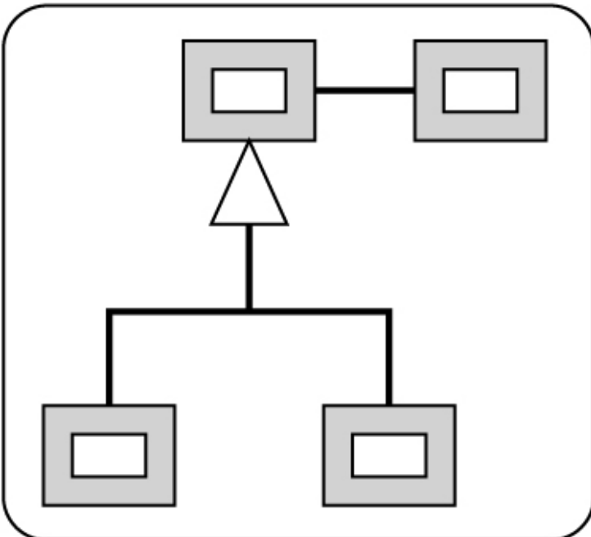
Design Patterns
A pattern is a solution to a general design problem
  In the form of a set of interacting classes
The classes need to be customized (white in figure)

Slide 14
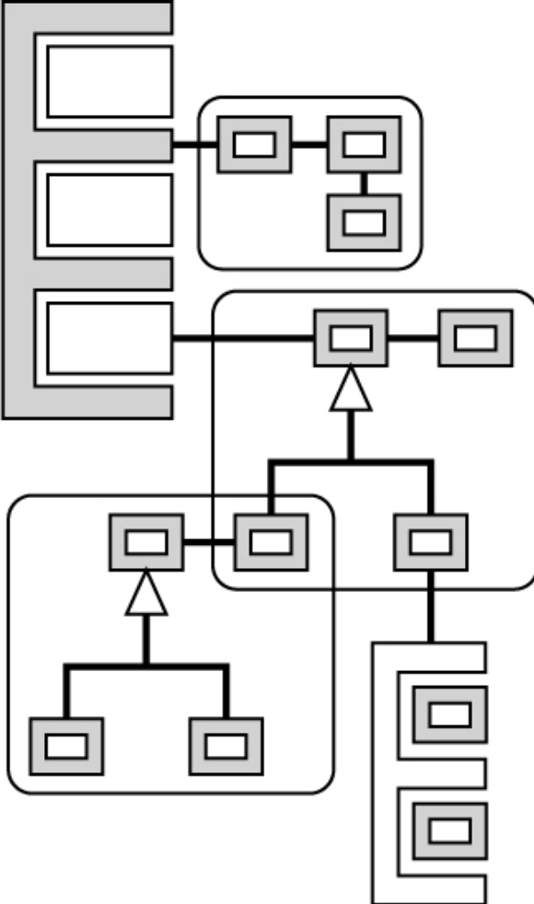
Design Patterns (contd)
If a design pattern is reused, then its implementation can also probably be reused (?)
Patterns can interact with other patterns

Slide 15
Software Architecture
Encompasses various design issues:
  Organization in terms of components
  How those components interact
Sample architecture:
  A toolkit
  A framework, and
  Three design patterns

Slide 16
Reuse of Software Architecture
Architecture reuse can lead to large-scale reuse
One mechanism: Software product lines
Case study:
  Firmware for Hewlett-Packard printers (1995-98)
    Person–hours to develop firmware decreased by a factor of 4
    Time to develop firmware decreased by a factor of 3
    Reuse increased to over 70% of components

Slide 17
Component-Based Software Engineering
Goal: To construct all software out of a standard collection of reusable components
  Using an automated tool
Would lead to an order-of-magnitude increase in productivity
Currently a research topic
  Exact specification of components?

Slide 18
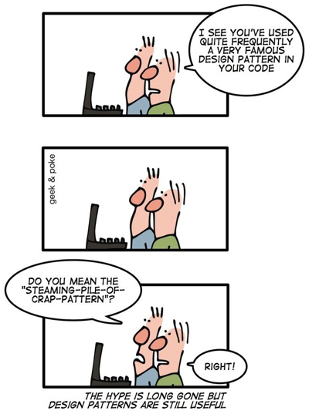
Sample Design Patterns
Adapter
Bridge
Composite
Iterator
Patterns in JUnit Design

Slide 19
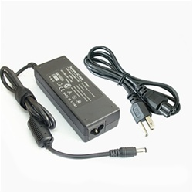
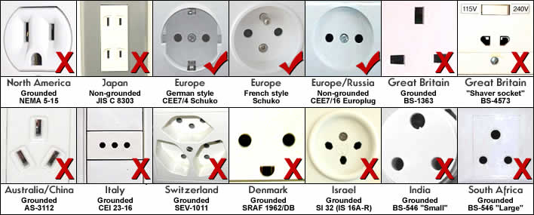
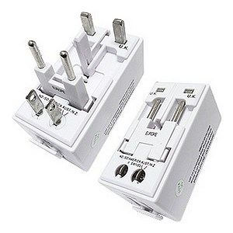

The Incompatibility Problem
?
Universal Power Adapter
USB charger

Slide 20
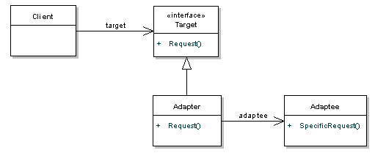
Adapter Pattern
Solves the general incompatibility problem
  A client wants to use existing but incompatible code (called adaptee)
Sort int numbers
Sort Integer Objects
Notes:
The Target interface defines the domain specific interface that the Client used.
The Adaptee is the existing interface that needs adapting in order for the Client to interact with it.
The Adapter adapts the Adaptee to the Target interface - it translates the request from the client to the adaptee.

Slide 21
Adapter Example
Adaptee: a third party implementation of a number sorter that deals with Lists, not arrays.
public class NumberSorter {
public List<Integer> sort(List<Integer> numbers) {
//sort and return
}
}
Client: deals with primitive arrays. Assume we can't change the client to use Lists.
int[] numbers = new int[]{34, 2, 4, 12, 1};
Sorter sorter = new SortListAdapter();
sorter.sort(numbers);

Slide 22
Adapter Example - cont
Target interface
public interface Sorter {
public int[] sort(int[] numbers);
}
Adapter: implements target and deals with the adaptee,
public class SortListAdapter implements Sorter {
public int[] sort(int[] numbers) {
convert array to list numberList;
NumberSorter sorter = new NumberSorter();
numberList = sorter.sort(numberList);
convert the list back to an array and return
}
}

Slide 23
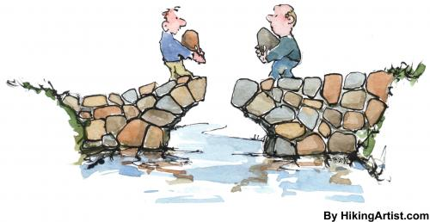
Bridge

Slide 24
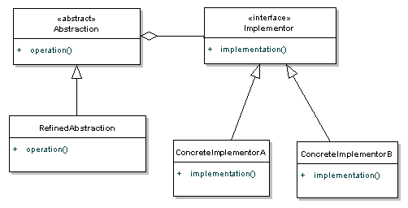
Bridge Pattern
To decouple an abstraction from its implementation so that the two can be changed independently
  Sometimes called a driver (e.g., a printer driver or a video driver)
Notes:
The Abstraction defines the abstraction, and maintains the reference to the implementor. RefinedAbstraction provides an extension to the Abstraction, usually adding extra methods that provide different ways of getting at the same functionality. The Implementor interface defines an interface for the implementation classes (the ConcreateImplementor classes).
RefinedAbstractions are implemented in terms of the abstraction, and not that implementation interface. This means that the implementation details are hidden from the client. The pattern is similar to the Adapter pattern, except the Bridge pattern separates the interface from implementation.

Slide 25
Remote Control for TVs
Remote Control
TV interface
Sony TV
Philips TV
Concrete Remote Control

Slide 26
Remote Control: Abstraction
public abstract class RemoteControl {
private TV implementor;
public void on() {
implementor.on();
}
public void off() {
implementor.off();
}
public void setChannel(int channel) {
implementor.tuneChannel(channel);
}
}

Slide 27
Remote Control: Refined Abstraction
public class ConcreteRemote extends RemoteControl {
private int currentChannel;
public void nextChannel() {
currentChannel++;
setChannel(currentChannel);
}
public void prevChannel() {
currentChannel--;
setChannel(currentChannel);
}
}

Slide 28
Remote Control: Implementors
public interface TV {
public void on();
public void off();
public void tuneChannel(int channel);
}
public class Sony implements TV {
public void on() {Sony specific on}
public void off() {Sony specific off }
public void tuneChannel(int channel) { …}
}
public class Philips implements TV {
public void on() {Philips specific on}
public void off() {Philips specific off}
public void tuneChannel(int channel) {…}
}

Slide 29
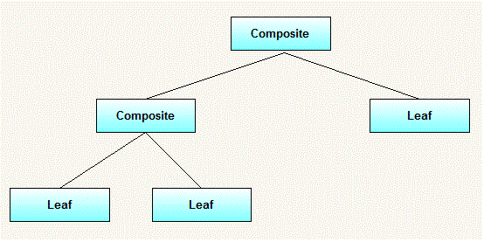
Composite Pattern - cont
Compose objects into tree structure to represent part-whole hierarchies.
Composite lets client treat individual objects and compositions of objects uniformly
Examples: employee/manager; test suite; menu; directory; graphic shape
Notes:
Employee/manager: manager is an employees also manages a group of employees.
Test suite: test case or test suite
Menu: menu item or menu
Directory: file or directory
Shape (e.g., line, rectangle)

Slide 30
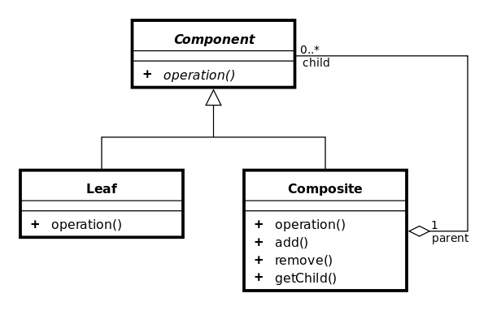
Composite Pattern - cont

Slide 31
Composite Pattern - cont
Employee
Developer
Manager

Slide 32
Composite Pattern: Example
public interface Employee {
public String getName();
public double getSalary();
public void print();
}
public class Developer implements Employee{
public Developer(String name,double salary){ …}
public String getName() {return name; }
public double getSalary() { return salary; }
public void print() { … }
}

Slide 33
Composite Pattern: Example
public class Manager implements Employee {
  private List<Employee> employees = new ArrayList<Employee>();
  …
  public Manager(String name,double salary){ }
  public void add(Employee employee) {…}
  public Employee getChild(int i) {…}
  public void remove(Employee employee) {}
  public String getName() {…}
  public double getSalary() {…}
  public void print() {
  Iterator<Employee> employeeIterator = employees.iterator();
  … }
}

Slide 34
Composite Pattern: Example
public class CompositePatternTest {
  public static void main(String[] args) {
  Employee emp1=new Developer("John", 10000);
  Employee emp2=new Developer("David", 15000);
  Employee manager1=new Manager("Daniel",25000);
  manager1.add(emp1);
  manager1.add(emp2);
  Employee emp3=new Developer("Michael", 20000);
  Manager generalManager=new Manager("Mark", 50000);
  generalManager.add(emp3);
  generalManager.add(manager1);
  generalManager.print();
  }
}

Slide 35
Iterator Design Pattern
An aggregate object is an object that contains other objects grouped together as a unit
  Examples: linked list, hash table
An iterator allows a programmer to traverse the elements of an aggregate object without exposing the implementation of that aggregate
Example: television remote control
  Keys increase (up or ①) or decrease (down or ②) the channel number without the viewer having to specify the current channel number

Slide 36
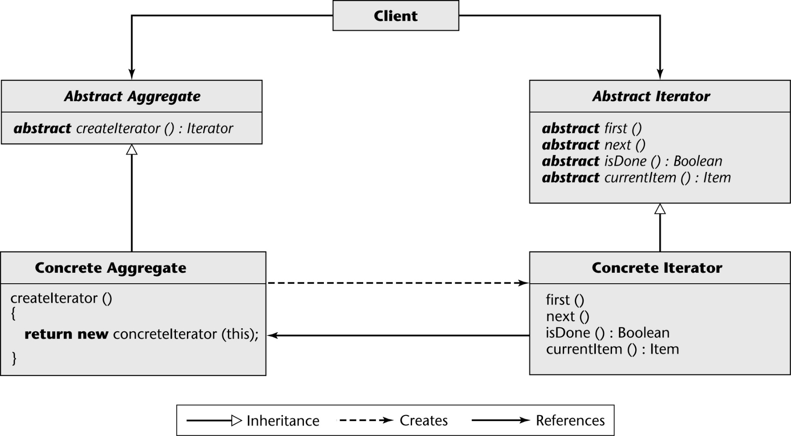
Iterator Design Pattern (contd)
Notes:
A Client object deals with only Abstract Aggregate and Abstract Iterator (essentially interfaces)
The Client object asks the Abstract Aggregate object to create an iterator for the Concrete Aggregate object
It utilizes the returned Concrete Iterator to traverse the contents of the aggregate.
The Abstract Aggregate object has an abstract method createIterator that returns an iterator to the Client object
The Abstract Iterator interface defines the basic four abstract traversal operations first, next, isDone, currentItem
Implementation of these five methods is achieved at the next level of abstraction, in Concrete Aggregate (createIterator), and in Concrete Iterator (first, next, isDone, currentItem)

Slide 37
Iterator Example
private TV myTV;
TV Interface
ChannelIterator Interace
ChannelIterator getChannelIterator()
public boolean hasNext();
public void next();
public String currentItem();
Concrete TV
ConcreteChannelIterator
ChannelIterator getChannelIterator(){
}
public boolean hasNext();
public void next();
public String currentItem();

Slide 38
TV and ConcreateTV
public interface TV {
public ChannelIterator getChannelIterator();
// …other TV methods
}
public class ConcreteTV implements TV {
private ChannelIterator iterator;
private List<String> channels;
public ConcreteTV() {
iterator = new ConcreteChannelIterator(channels);}
public ChannelIterator getChannelIterator() {
return iterator;}
}

Slide 39
ChannelIterator Interface
public interface ChannelIterator {
public boolean hasNext();
public void next();
public String currentItem();
}

Slide 40
ConcreteChannelIterator
public class ConcreteChannelIterator implements ChannelIterator {
private List<String> channels;
private int currentPos = 0;
public ConcreteChannelIterator(List<String> channels) {
this.channels = channels; }
public boolean hasNext() {
return currentPos + 1 < channels.size();}
public void next() { currentPos++; }
public String currentItem() {
return channels.get(currentPos); }
}

Slide 41
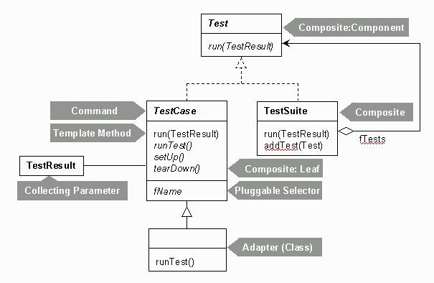
Patterns in JUnit Design

Slide 42
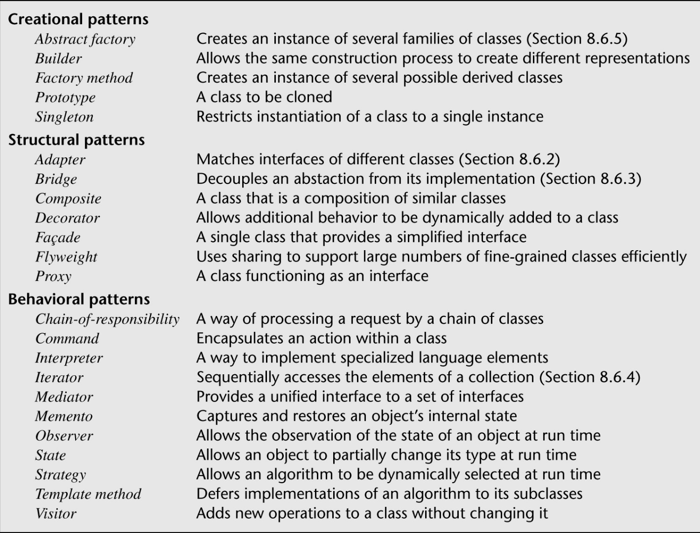
Categories of Design Patterns
The 23 “Gang of Four” design patterns are grouped into three categories:

Slide 43
Strengths of Design Patterns
Design patterns promote reuse by solving a general design problem
Design patterns provide high-level design documentation (design abstractions)
Implementations of many design patterns exist
A maintenance programmer can easily comprehend a program

Slide 44
Weaknesses of Design Patterns
The use of the 23 standard design patterns may be an indication that the language we are using is not powerful enough
There is as yet no systematic way to determine when and how to apply design patterns

Slide 45
Patterns and Reuse – Traps
Force-fitting code to use a pattern
  If the code has to be shifted too far, forcing it to look like a standard pattern can increase complexity
Feature-itis
  Using a pattern because of a desire to try out a pattern rather than because the pattern is an appropriate design solution.
  Steve McConnell. Code Complete: A Practical Handbook of Software Construction. 2nd Edition. Microsoft Press, 2004.

Slide 46
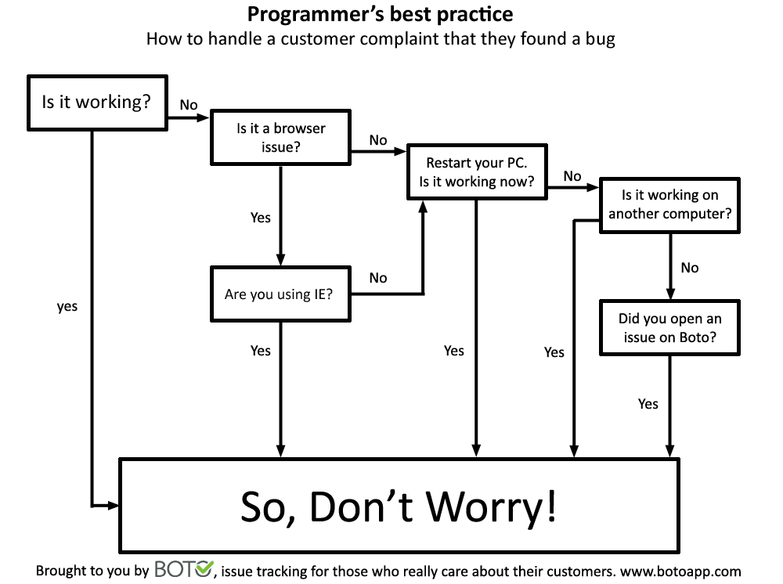

Slide 47
Portability
Program P Compiled by compiler C₁, then runs on machine M₁ under operating system O₁
We want to make P run on machine M₂ under operating system O₂
What are the potential reasons that we are unable to run P on M2/O2?

Slide 48
Portability: textbook
Product P,
  Compiled by compiler C₁, then runs on machine M₁ under operating system O₁
Need product P', functionally equivalent to P
  Compiled by compiler C₂, then runs on machine M₂ under operating system O₂
P is portable if it is cheaper to convert P into P' than to write P' from scratch (?)

Slide 49
Hardware Incompatibilities
Storage media incompatibilities
  Example: Zip vs. DAT
Character code incompatibilities
  Example: Unicode -> ASCII
Word size
  Differences in word size can affect accuracy

Slide 50
Operating System Incompatibilities
Job control languages (JCL) can be vastly different
  Syntactic differences
Virtual memory vs. overlays

Slide 51
Language and Compiler Incompatibilities
FORTRAN standard
C standard
  Most compilers use the pcc front end
  The lint processor aids portability
ANSI C++ standard
Java

Slide 52
Why Portability?
Portability is critical
  Good software lasts 15 years or more
  Hardware is changed every 4 years
Upwardly compatible hardware works
  But it may not be cost effective
Portability can lead to increased profits
  Multiple copy software
  Documentation (especially manuals) must also be portable

Slide 53
Techniques for Achieving Portability
Use popular language and standard constructs
Portable data
  File formats are often operating system-dependent
  Avoid numerical incompatibilities
Utilize levels of abstraction and isolate implementation-dependent pieces
  Example: UNIX kernel, device-drivers
  Example: Graphical display routines
Document meticulously

Slide 54
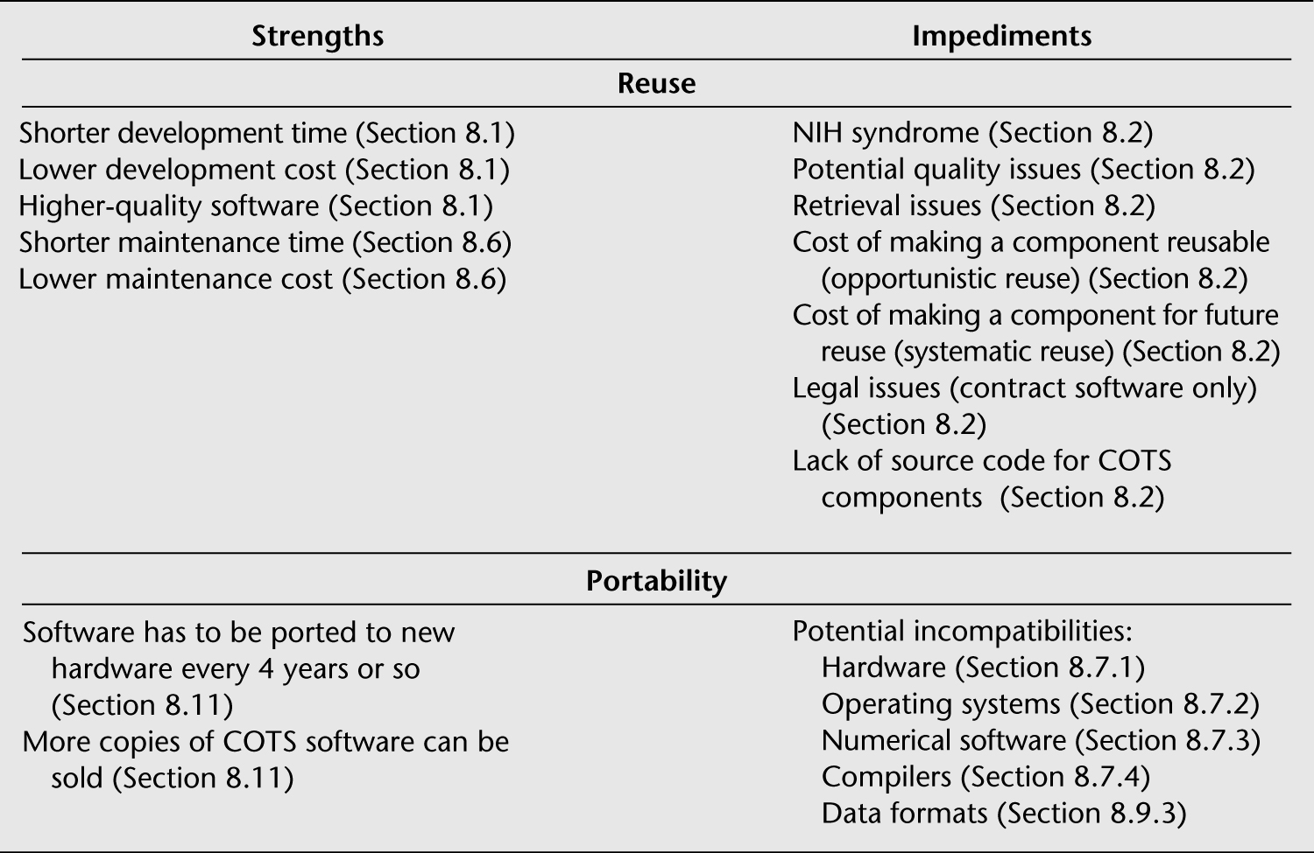
Strengths of and Impediments to Reuse and Portability

